Slide 1
Pitch Shifting With C++
Grant Cox
Honors CS315
12/12/2017

Slide 2
Abstract
Pitch shifting requires transforming time domain data into the frequency domain
Data is then pitch shifted with processing
Data is moved back to the time domain
The program conveniently handles .wav files, a common audio format

Slide 3
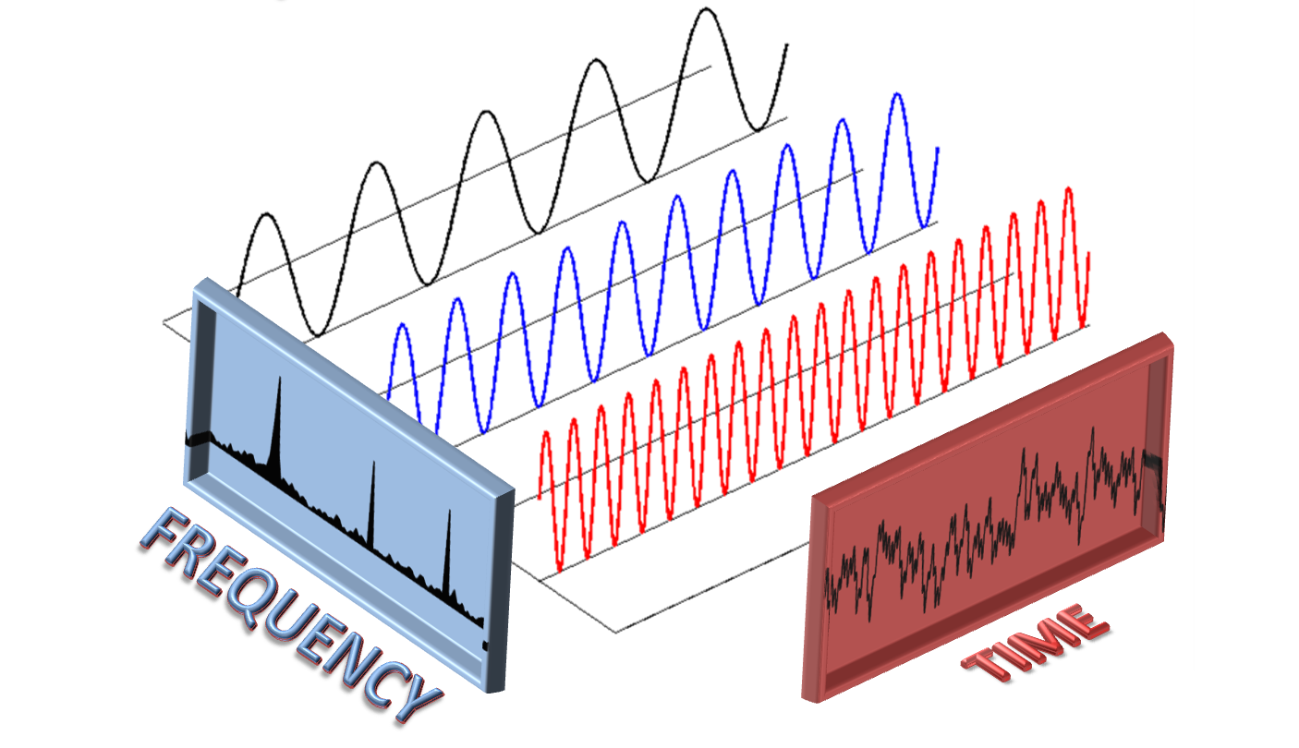
Problem Statement
Practice music and want to pitch shift
Wanted easy pitch shifting without Audacity
How does it work? This can’t be done with a single FFT, but requires many over small chunks of data
This is very useful to me, and would be very useful to many musicians
http://people.csail.mit.edu/haitham/Pictures/sFFT.png

Slide 4
Why Is it Important?
Audio and music professionals use pitch shifting all the time.
Autotune
Synthesizer Vocoders
Anonymity (warped voices)
Enhancement
For me to pitch shift a recording without this tool, it takes around 15 to 20 clicks in Audacity and I still have to wait for it to render. This takes three words on the command line and works very simply.

Slide 5
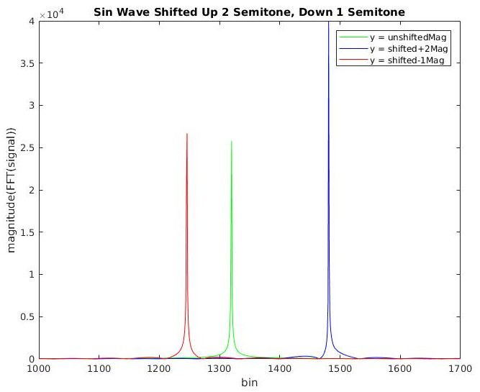
Examples
Here, a simple sine wave was shifted down one key and up two. It is clear that the dominating frequency has been shifted as I intended.
-What causes the amplitude jump?

Slide 6
Solution
Load .wav data using File IO into an array
Pass the array to the pitch shifting algorithm
Use frames to analyze small pieces of the data such that the wave will look to have a constant frequency inside of that frame
Pitch shift the frame by the constant multiplier
Pitch shift all the frames
Write data with File IO to new .wav file and free memory

Slide 7
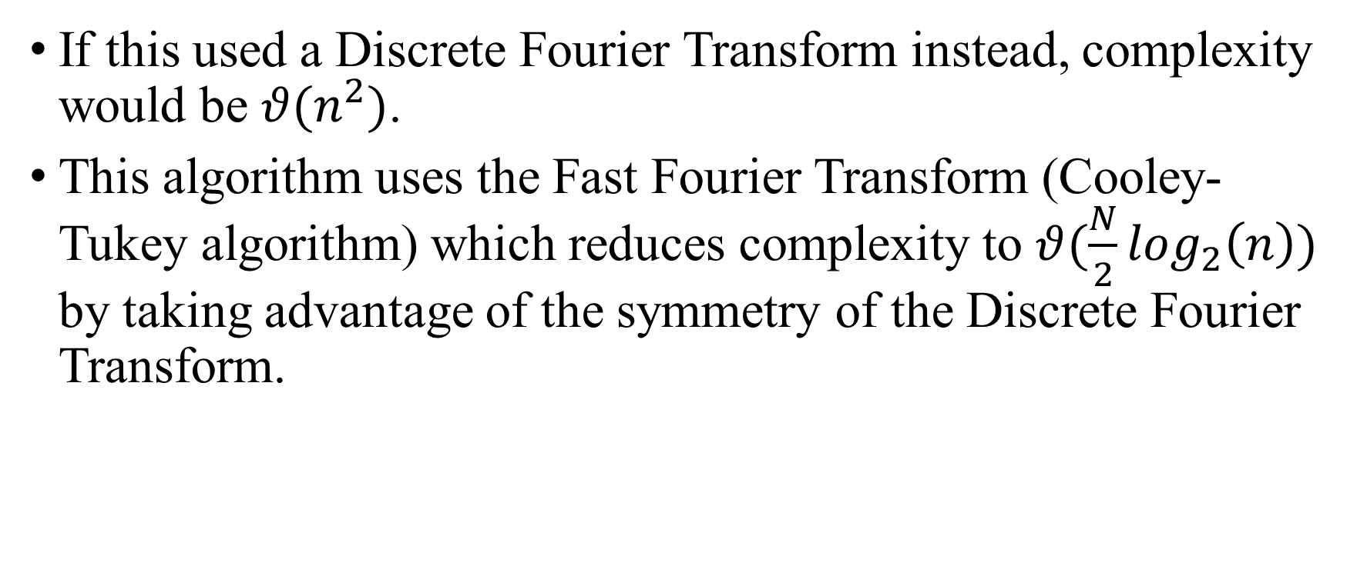
Complexity
If this used a Discrete Fourier Transform instead, complexity would be $θ(n^{2})$.
This algorithm uses the Fast Fourier Transform (Cooley-Tukey algorithm) which reduces complexity to $θ(\frac{N}{2}\log_{2}\left(n\right))$ by taking advantage of the symmetry of the Discrete Fourier Transform.

Slide 8
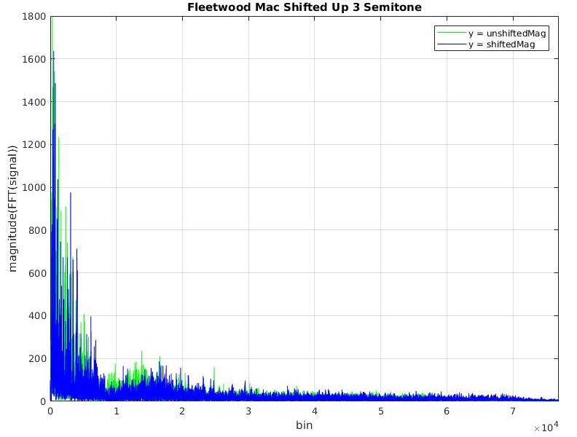
Fleetwood
Example: Clip from “Second Hand News” by Fleetwood Mac shifted up 3 semitones. Notice the frequency shift.

Slide 9
What’s Next?
Test performance vs. the Sigpack FFT algorithm
Make a GUI for layman use
Add ability to give it an entire file, but only shift part of it and output it to a new file

